Slide 1
Bible Study Tools
www.LetGodBeTrue.com

Slide 2
Get a Vision (1)
“This Ezra went up from Babylon; and he was a ready scribe in the law of Moses, which the LORD God of Israel had given ….”
Ezra 7:6

Slide 3
Get a Vision (2)
“But there is a spirit in man: and the inspiration of the Almighty giveth them understanding.”
Job 32:8

Slide 4
Get a Vision (3)
“The entrance of thy words giveth light; it giveth understanding unto the simple.”
Psalm 119:130

Slide 5
Get a Vision (4)
“These were more noble than those in Thessalonica, in that they received the word with all readiness of mind, and searched the scriptures daily, whether those things were so.”
Acts 17:11

Slide 6
Get a Vision (5)
“We have also a more sure word of prophecy; whereunto ye do well that ye take heed, as unto a light that shineth in a dark place, until the day dawn, and the day star arise in your heart.”
II Peter 1:19

Slide 7
The Bible
2 Testaments
66 Books
1189 Chapters
31,101 Verses
12,143 Words
783,137 Word Occurrences

Slide 8
Study WORDS (1)
“Which things also we speak, not in the words which man’s wisdom teacheth, but which the Holy Ghost teacheth; comparing spiritual things with spiritual.”
I Corinthians 2:13
“And Jesus answered him, saying, It is written, That man shall not live by bread alone, but by every word of God.”
Luke 4:4

Slide 9
Study WORDS (1)
“Which things also we speak, not in THE WORDS which man’s wisdom teacheth, but which the Holy Ghost teacheth; comparing spiritual things with spiritual.”
I Corinthians 2:13
“And Jesus answered him, saying, It is written, That man shall not live by bread alone, but by EVERY WORD of God.”
Luke 4:4

Slide 10
Study WORDS (2)
Find all occurrences to learn the Spirit’s usage
Find a verse because you know a word in it
Find related verses that have the same word
Find the different meanings of the same word
Find alternative names for the same person, etc.

Slide 11
Study VERSES (1)
“The place of the scripture which he read was this, He was led as a sheep to the slaughter; and like a lamb dumb before his shearer, so opened he not his mouth” (Acts 8:32).
When ye therefore shall see the abomination of desolation, spoken of by Daniel the prophet, stand in the holy place, (whoso readeth, let him understand:)
Matthew 24:15

Slide 12
Study VERSES (1)
“The PLACE OF THE SCRIPTURE which he read was this, He was led as a sheep to the slaughter; and like a lamb dumb before his shearer, so opened he not his mouth” (Acts 8:32).
When ye therefore shall see the abomination of desolation, SPOKEN OF BY DANIEL THE PROPHET, stand in the holy place, (whoso readeth, let him understand:)
Matthew 24:15

Slide 13
Study VERSES (2)
You want to know the true sense of a Bible verse
Your wife, children, or a friend ask about a verse
You hear a verse abused and want to correct it
You have an opportunity to speak and want to know the full sense of a verse to teach it to others

Slide 14
Study CONCEPTS (1)
“So they read in the book in the law of God distinctly, and gave the sense, and caused them to understand the reading.”
Nehemiah 8:8
“Study to shew thyself approved unto God, a workman that needeth not to be ashamed, rightly dividing the word of truth.”
II Timothy 2:15

Slide 15
Study CONCEPTS (1)
“So they read in the book in the law of God distinctly, and gave THE SENSE, and caused them to understand the reading.”
Nehemiah 8:8
“Study to shew thyself approved unto God, a workman that needeth not to be ashamed, RIGHTLY DIVIDING the word of truth.”
II Timothy 2:15

Slide 16
Study CONCEPTS (2)
The sound of words is very inferior to their sense
We want to understand the intent of scripture
We want to be able to interpret and understand it
The Bible is not a book of sound bites from words
Concepts or doctrines use many different words

Slide 17
Six Study Tools
Word-Based | Verse-Based | Concept-Based
Concordance | Treasury of Scripture Knowledge | Nave’s Topical Bible
Bible Dictionary | Bible Commentary | Systematic Theology

Slide 18
Concordance
Contains each occurrence of each word in the Bible. Organized alphabetically, it is the best tool to find a verse from a word and to find all the occurrences of a word. It may also contain the Hebrew and Greek words underlying each English word. Strong’s is the best, for it is exhaustive with several helpful features and the Hebrew and Greek. A concordance is word based – here is its value and its limitations.

Slide 19
Treasury of Scripture Knowledge
Contains over 500,000 cross-references to the verses in the Bible. In Bible order, it provides verses helping explain a text under study. The verses were taken from conservative commentaries and Bibles before 1900. It is the best tool for finding explanatory verses that may not contain the key words of your subject text. The Treasury is verse based – here is its value and its limitations.

Slide 20
Nave’s Topical Bible
This topical handbook organizes Bible verses and passages by well-known topics. By using key verses more than once, it contains over 100,000 references in over 20,000 topics. The Scriptures are fully printed, so you do not need your Bible to read the text. It also features a reverse lookup that allows you to find the topics where a verse has been used, in order to find other related verses by that topical classification. It is a topic based tool.

Slide 21
Six Study Tools
Word-Based | Verse-Based | Concept-Based
Concordance | Treasury of Scripture Knowledge | Nave’s Topical Bible
Bible Dictionary | Bible Commentary | Systematic Theology

Slide 22
Bible Dictionary
Organized alphabetically, it contains most every word in the Bible with a definition, illustration, description, historical reference, explanation, and/or cross-references. By its nature, it may include the author’s bias. It is word based. Useful dictionaries include the Concise, Smith, Easton, and Davis.

Slide 23
Bible Commentary
Organized Scripturally, it provides the author’s interpretation for each verse in the Bible. Due to its organization, you may quickly obtain an opinion on the interpretation of any verse. It is verse based. Useful commentaries include Poole, Henry, Barnes, Gill, and Clarke.

Slide 24
Systematic Theology
A handbook organized according to the author’s outline of theology with the author’s opinion and references providing the material under each heading. It is topic based. Useful theologies include Gill, Dagg, Boyce, Berkhof, and Dabney. There are many more, but very few will add much to these volumes.

Slide 25
Six Study Tools
Word-Based | Verse-Based | Concept-Based
Concordance | Treasury of Scripture Knowledge | Nave’s Topical Bible
Bible Dictionary | Bible Commentary | Systematic Theology

Slide 26
Six Study Tools
God blessed men with talents to construct them
Those men worked with great diligence for us
The combined tools can accomplish much easily
Combing the books back and forth is laborious
God has chosen to bless us above all others …

Slide 27
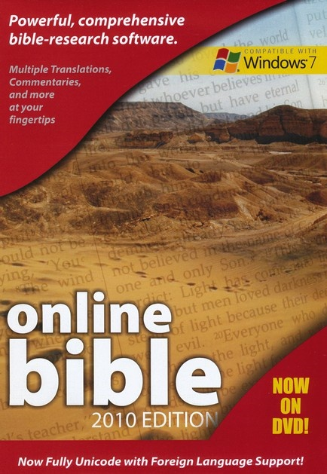
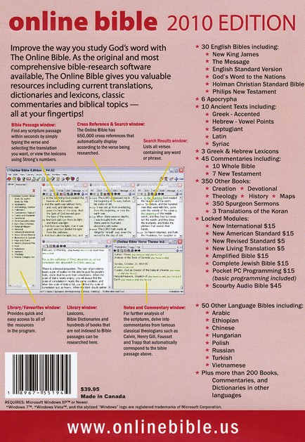
Introducing Online Bible 2010 DVD

Slide 30
The First and
the Best!
30 English
Bibles!
650k Cross-
References!
45 English
Commentaries!
Synchronized
Ultimate Tool!
350 Reference
Books!
Classic and
Conservative
Reference
Materials!
50+ Bibles
200+ Books
in other
Languages!

Slide 31
Installing Online Bible 2010 DVD
Follow the manual found inside the DVD’s case.
Select your preferred language … English.
Accept recommended installation suggestions.
Unless you purchase unlock codes, do not check to install locked material or Scourby’s audio.
Do not check screen reader mode or supplemental material.

Slide 32
Installing Online Bible 2010 DVD
Uncheck any language that you will not be using.
Do not worry about the “What Is New” info.
Do not interrupt the download to your hard drive.
When Online Bible opens, exit the help menu.
Close the program, reboot your computer, and double click on the desktop icon to reopen it.

Slide 33
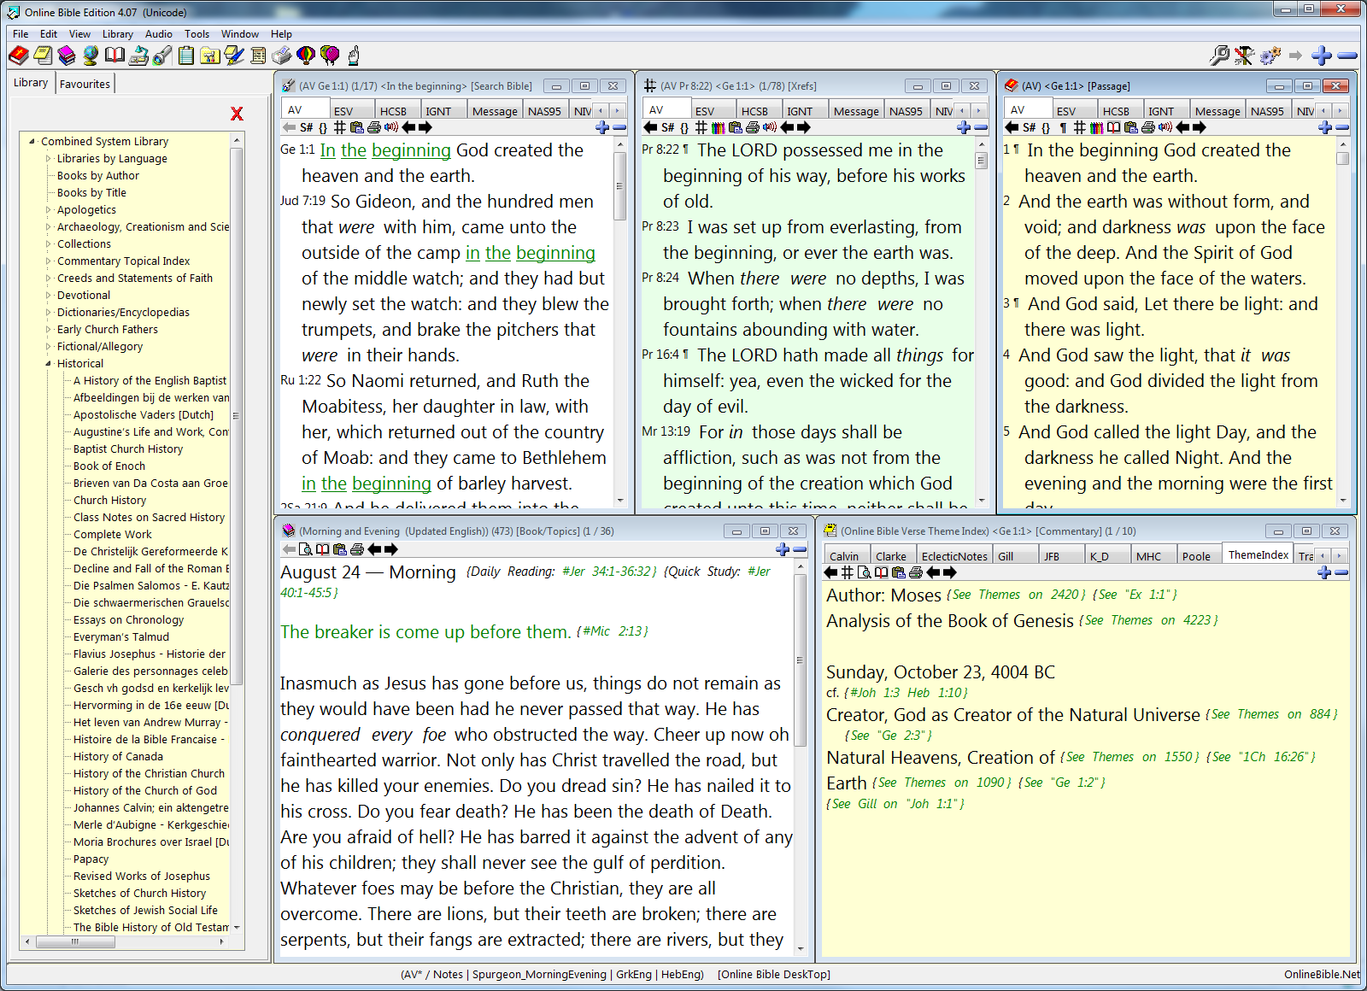
This is what it will look like!

Slide 34
Search
Bible
# Cross-
References
Bible
Passage
L
i
b
r
a
r
y
Books, songs,
dictionary, etc.
Commentary

Slide 35
Your own library of Bibles & books

Slide 36
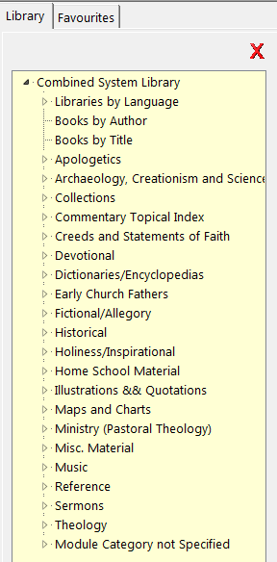
Click on the
arrows to open
any category.
Double click to
open a book.

Slide 37
Libraries by Language

Slide 38
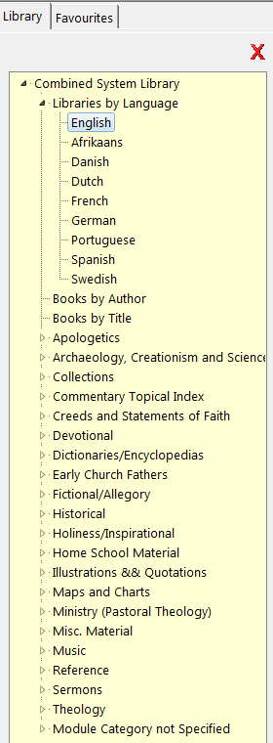
English
Afrikaans
Danish
Dutch
French
German
Portugese
Spanish
Swedish
Let’s try English

Slide 39
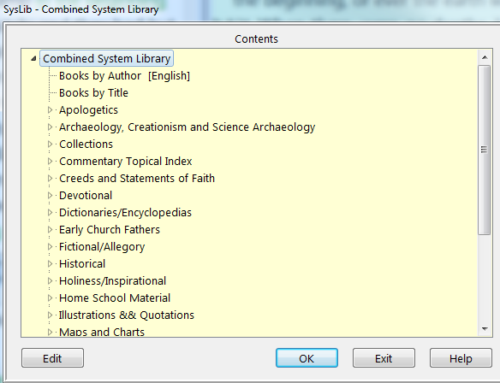
English library of Bibles & books

Slide 40
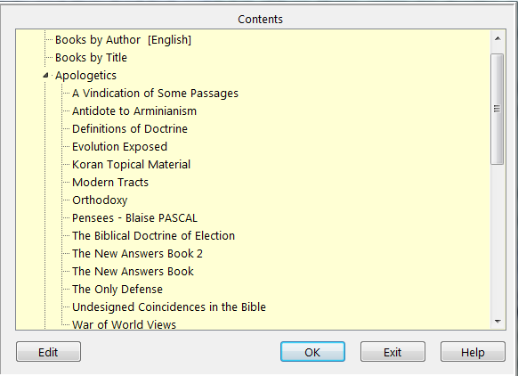
We have opened apologetics.

Slide 41
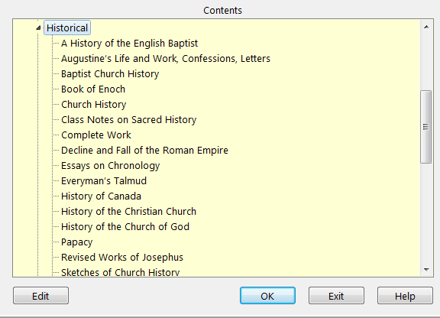
Joseph Ivimey
Trail of Blood
Eusebius
Gibbon
Hassell
Josephus

Slide 42

A 1650 Psalter!
A cyber hymnal!

Slide 43
We pick favorites elsewhere

Slide 44
We Want Reference Tools!
The library shows that you have a collection of hundreds of Bibles and religious books and aids.
But they are the least of Online Bible’s value.
We want the six Bible study tools computerized to find the sense of scripture quickly and easily.
Let’s look at the best parts of Online Bible.

Slide 45
X Out of Library

Slide 46
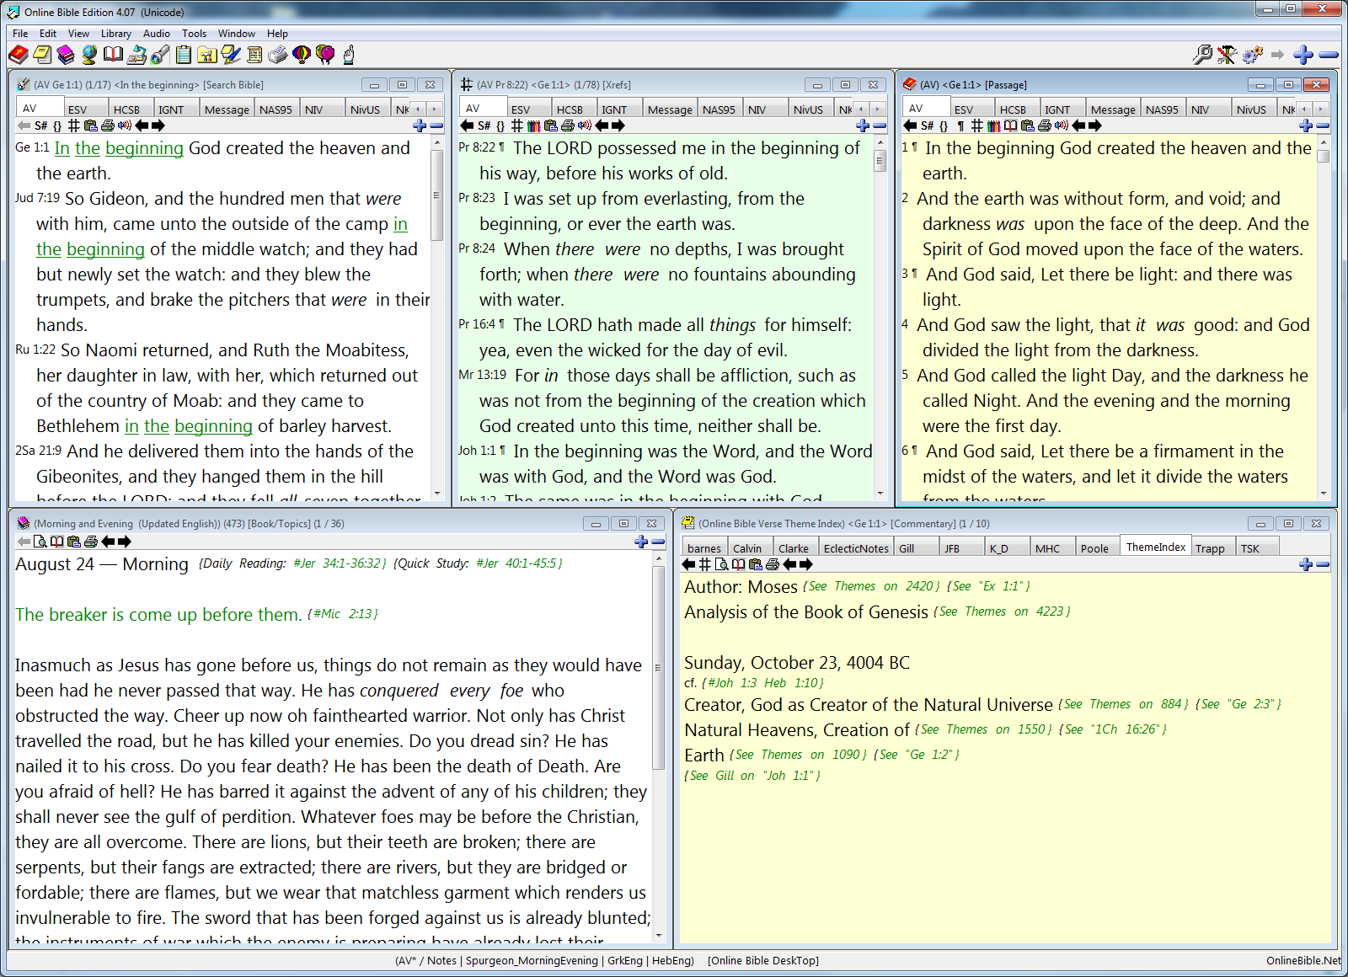
Window

Slide 47
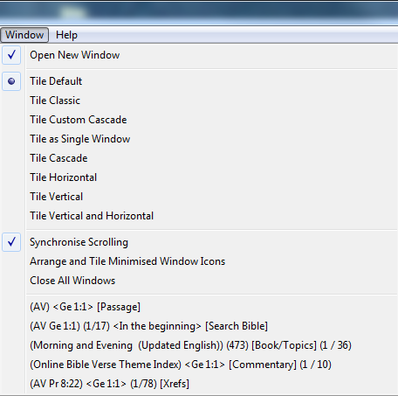
Tile Classic

Slide 48
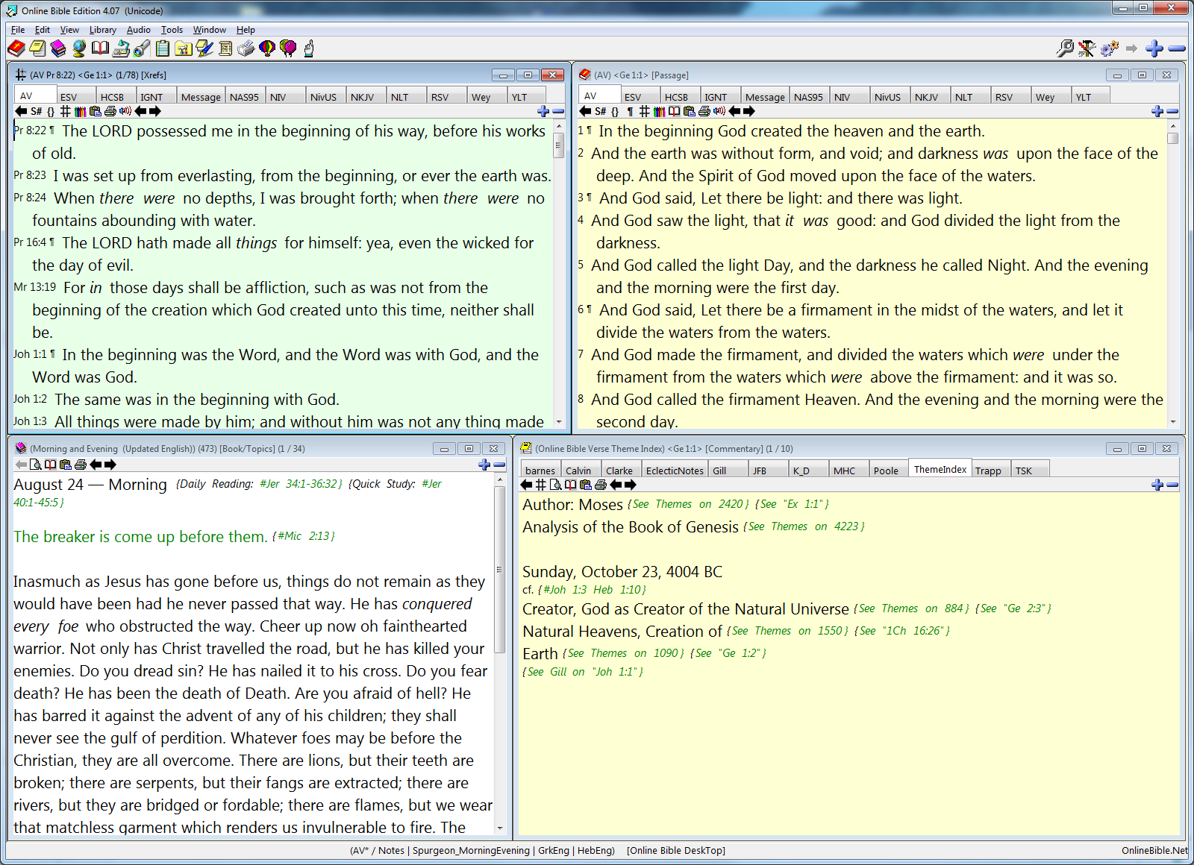

Slide 49
X out of window
Extend to left

Slide 50
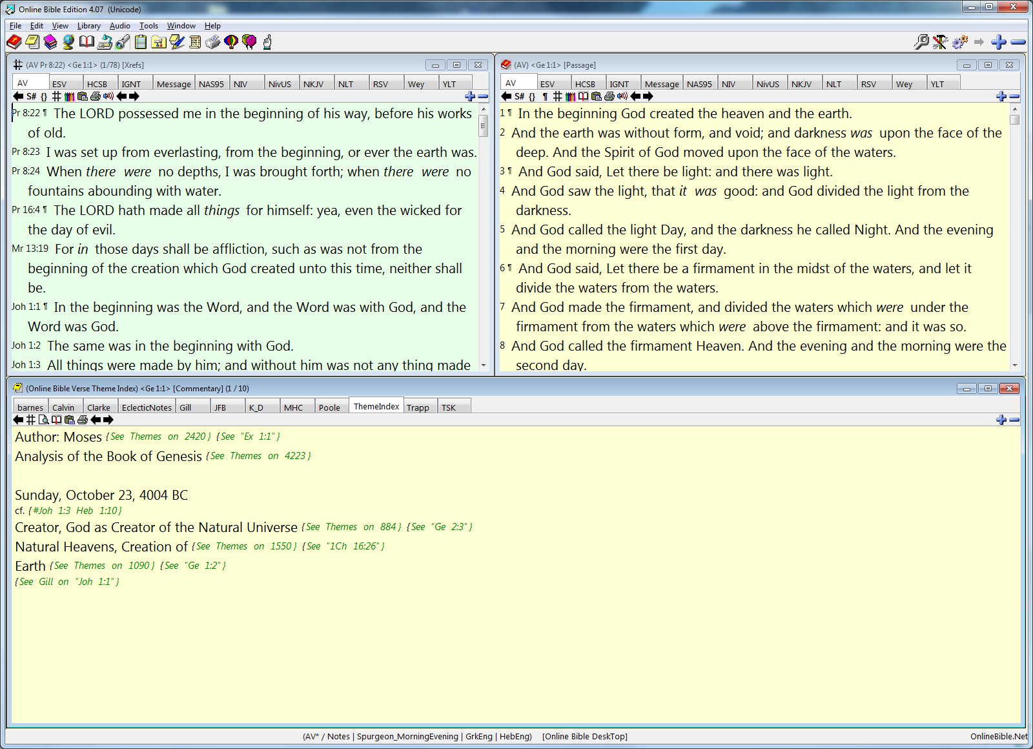

Slide 51
Enlarge Font

Slide 52
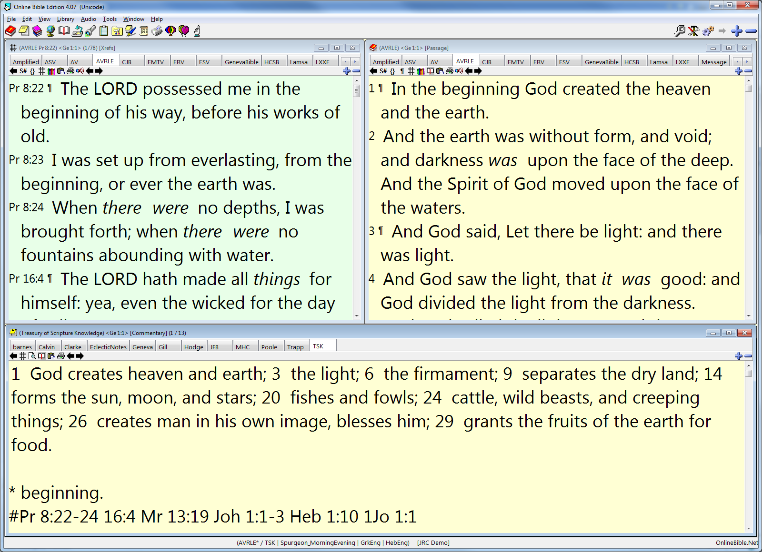
Much Better!

Slide 53
Click on Favorites

Slide 54
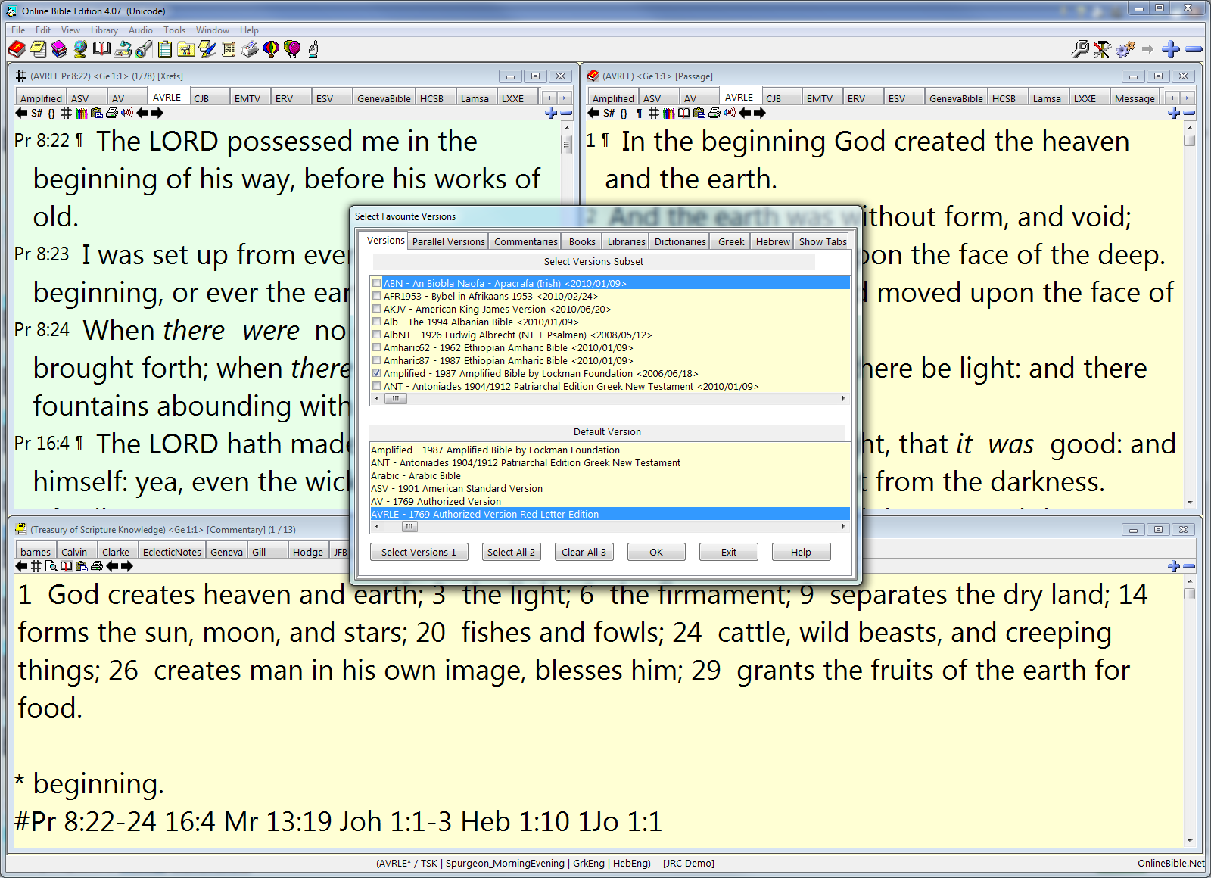

Slide 55
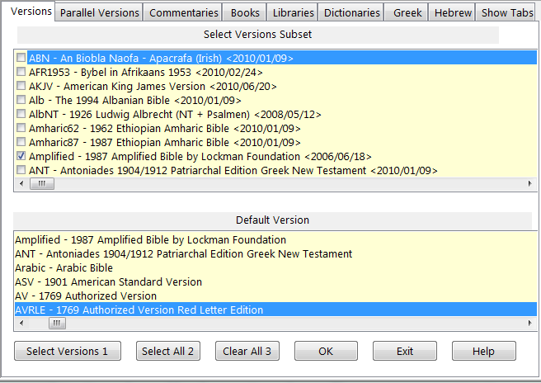
Bible Versions
Pick 5-10
Pick AV Favorite

Slide 56
Picking some Bible Versions
The AV (or King James) is our default, for we believe it is God’s word in the English language.
The AVRLE is the King James red letter edition.
Other versions are for comparison and information only – to provide help in saving friends from them.
Free versions: ASV, YLT, RSV, NKJV, ESV, The Message, and others. [Some versions demand a royalty.]

Slide 57
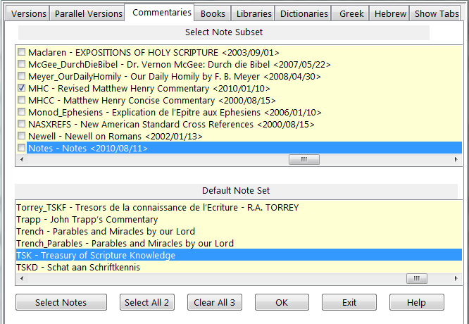
3-5 Good Commentaries
Best Default

Slide 58
The 5 Best Commentaries
Poole … concise, sober, balanced Nonconformist
Henry … devotional, sober, spiritual Presbyterian
Barnes … careful, thorough, logical Presbyterian
Gill … wordy, rabbinical, high Calvinist Baptist
Clarke … bold, opinionated, extreme Methodist

Slide 59
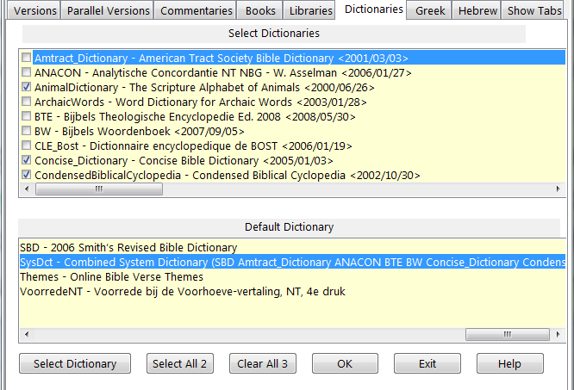
2-5 Good Dictionaries
Easton Is
Best Default

Slide 60
Picking Some Dictionaries
Concise … short, sweet, modern option.
Easton … esteemed, solid, moderate option.
ISBE … detailed, extensive encyclopedia.
Naves … topical Bible for subject research.
SysDct … a collection of various dictionaries.

Slide 61
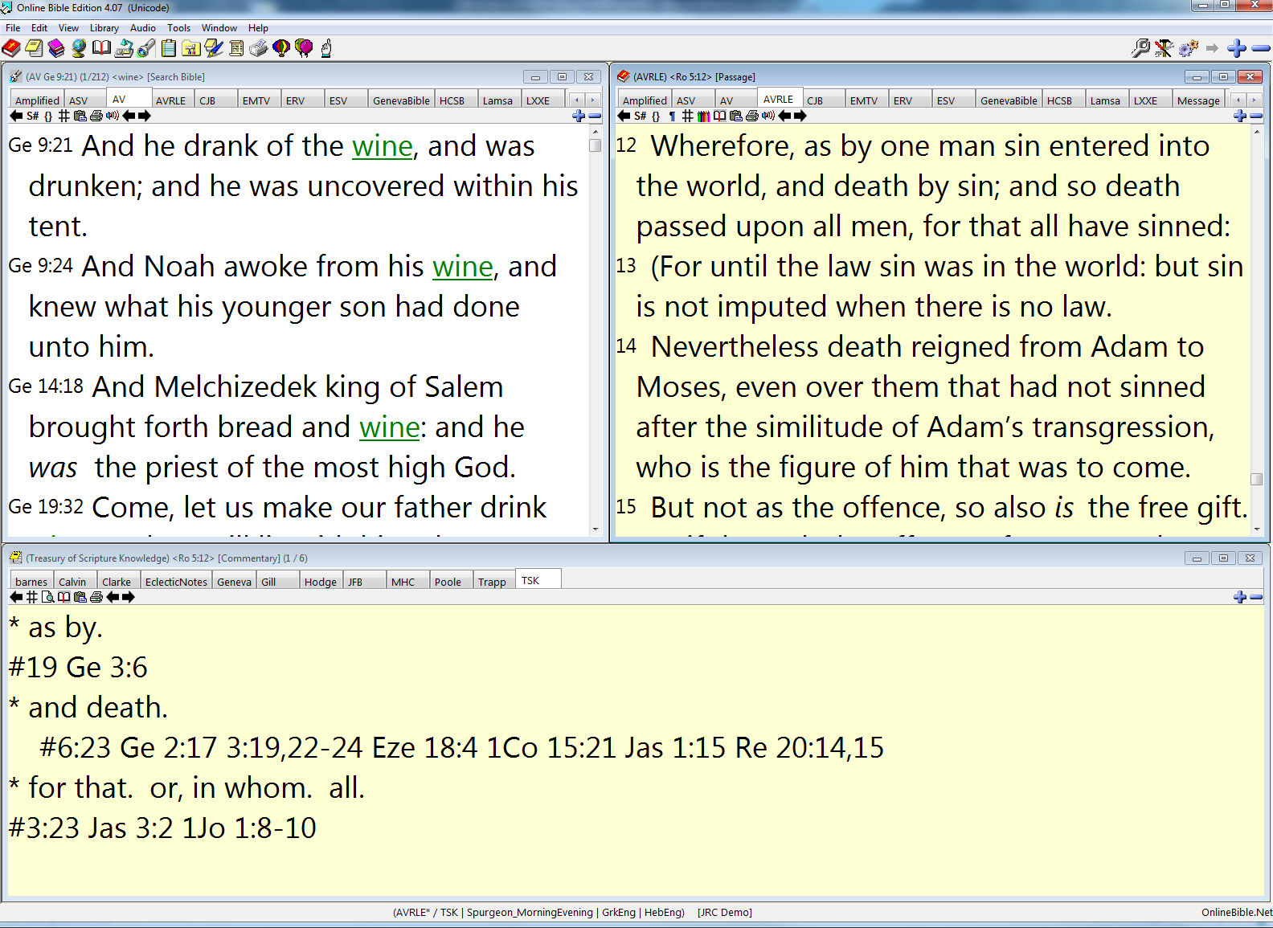
Your Bible Version Tabs
Your Bible Version Tabs
Your Commentary Tabs

Slide 62
Your Default is AV
Your Default is AVRLE
Your Default is the Treasury

Slide 63
Here Is Your Tool Bar

Slide 64
Click on the Bible to read or study a passage
And It Will Appear
In This Window

Slide 65
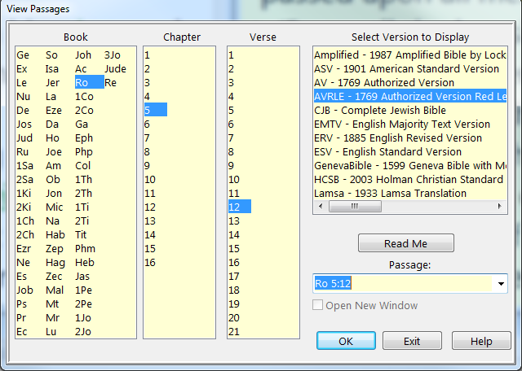
The Dialog Box Will Look Like This
You may select the book, chapter, verse
Or type reference with few letters and no colon

Slide 66
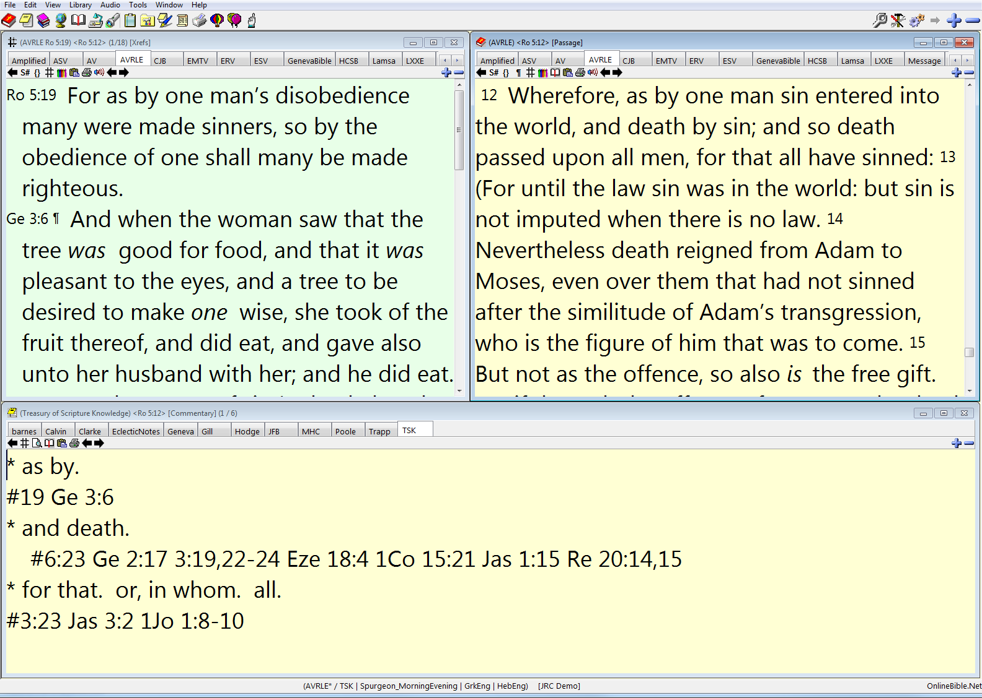
Romans 5:12
Rom 5:12 is where it should, and there
is more we will explore in a few slides.

Slide 67
Click on the flashlight to look up a word or phrase
The results of your search will appear in this window

Slide 68
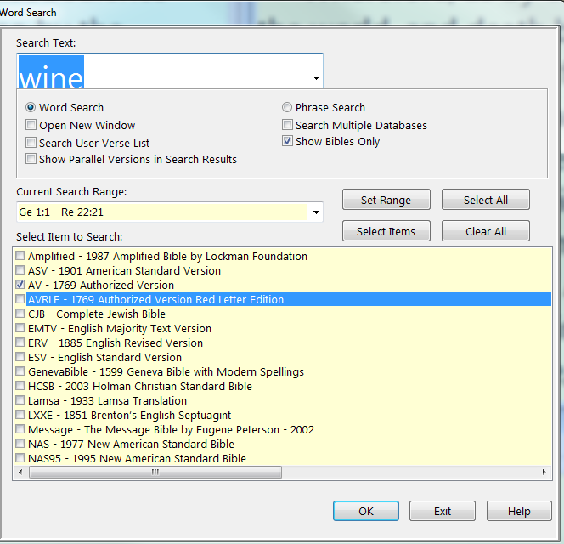
The Dialog Box Will Look Like This
Hunt a word or phrase
Search anywhere
Limit your search

Slide 69
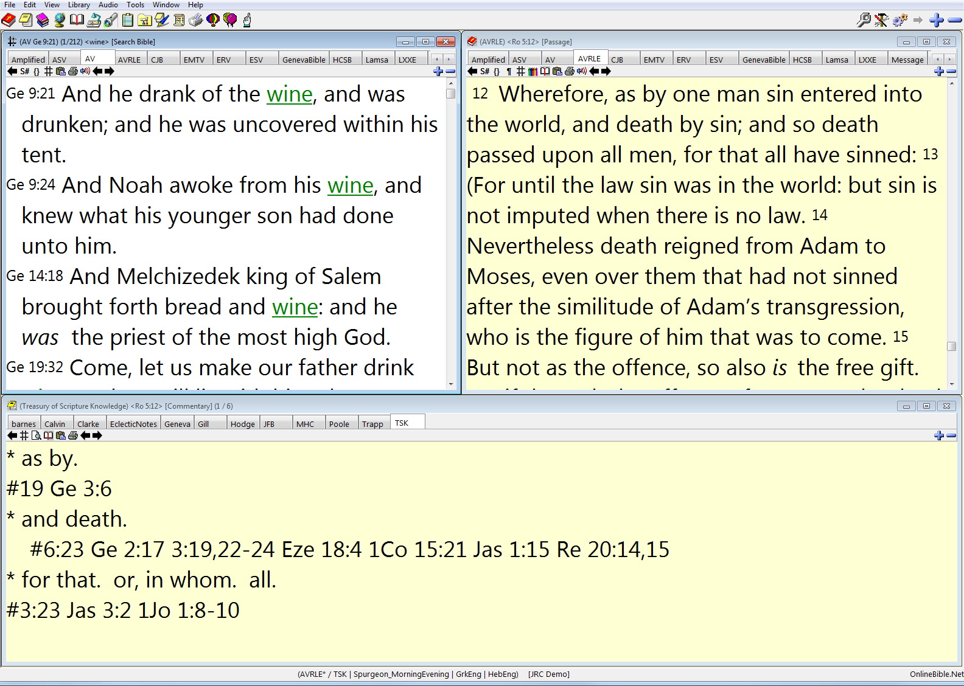
Wine
Wine
Wine
You have all the occurrences of “wine”
in the Bible, with “wine” highlighted.

Slide 70
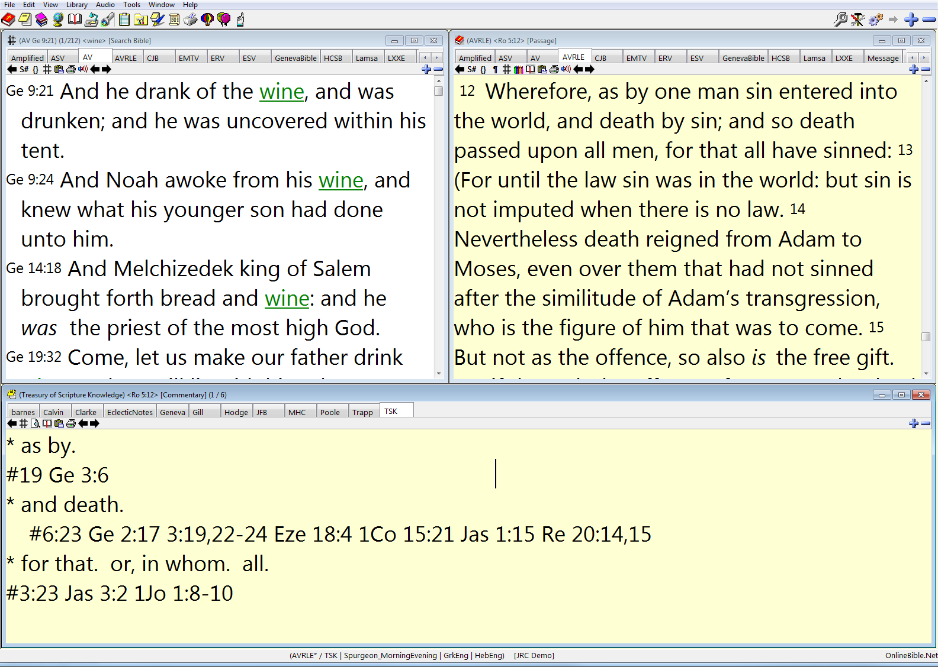
“Wine” occurs 212 times in the AV; Gen 9:21 is the first.

Slide 71
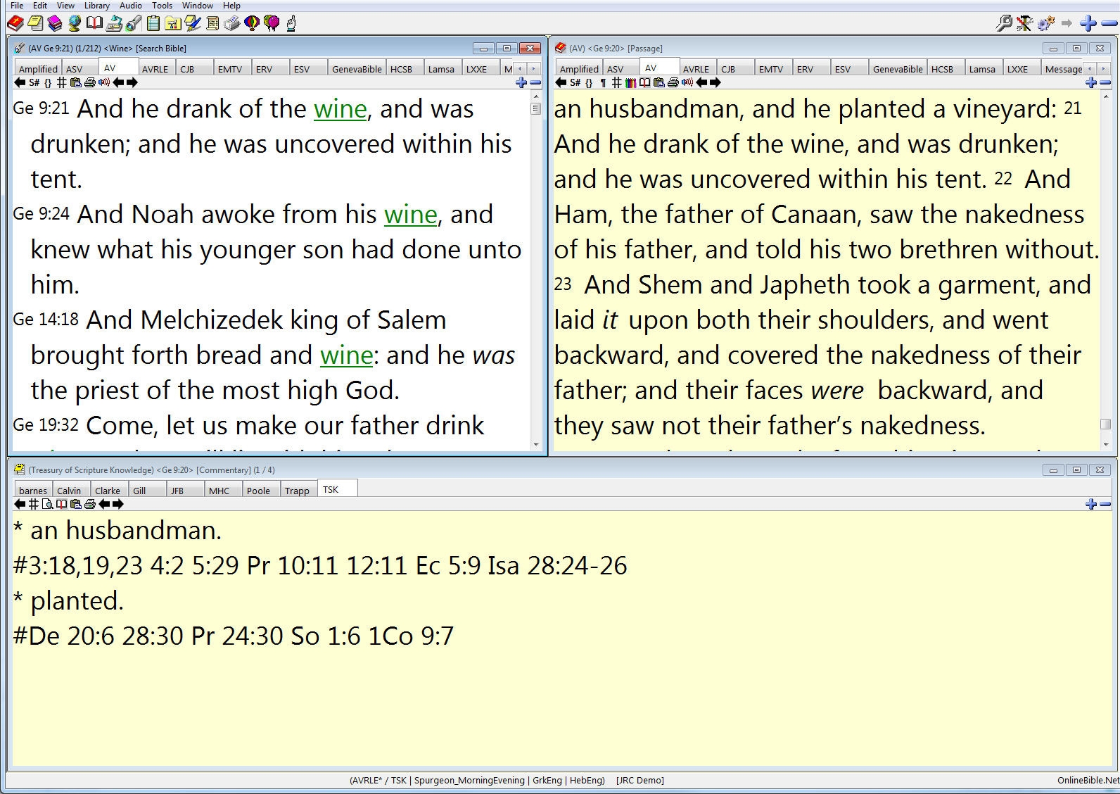
Genesis 9:21
Double clicking on any “wine” verse will
put the context in the Passage window.

Slide 72
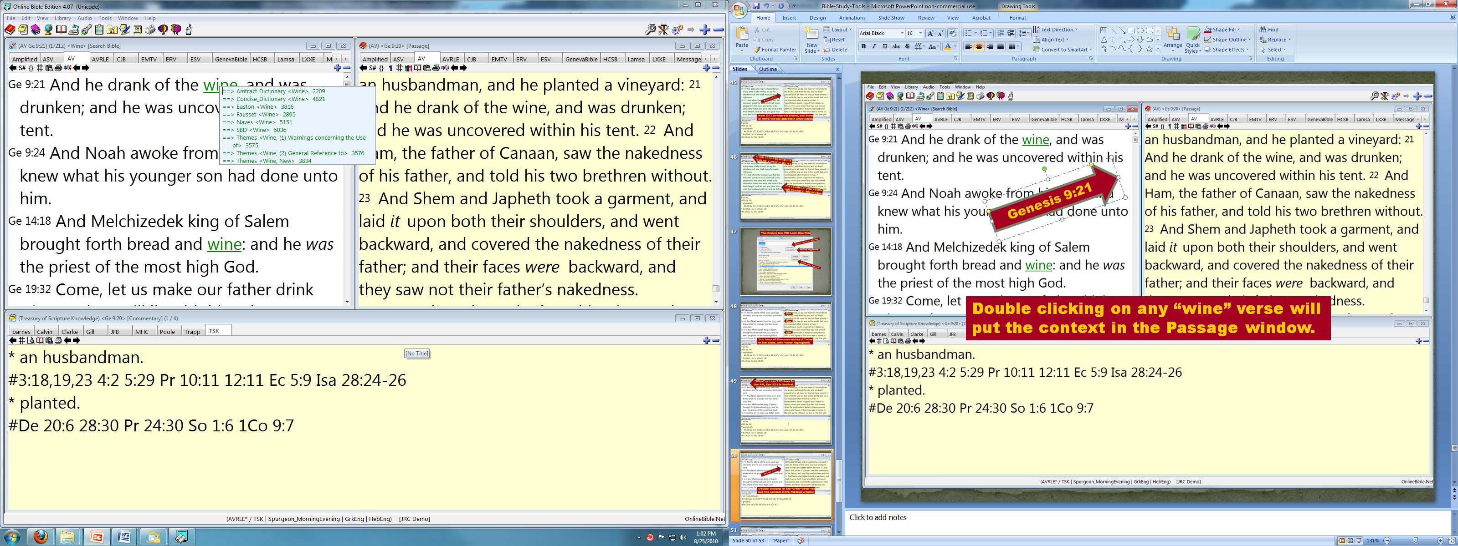
Pausing your cursor over “wine” or
any other word shows dictionaries

Slide 73
Double clicking any dictionary shown
will show its entry for “wine.”
If a specific dictionary was your default, its
entry for “wine” would immediately appear.

Slide 74
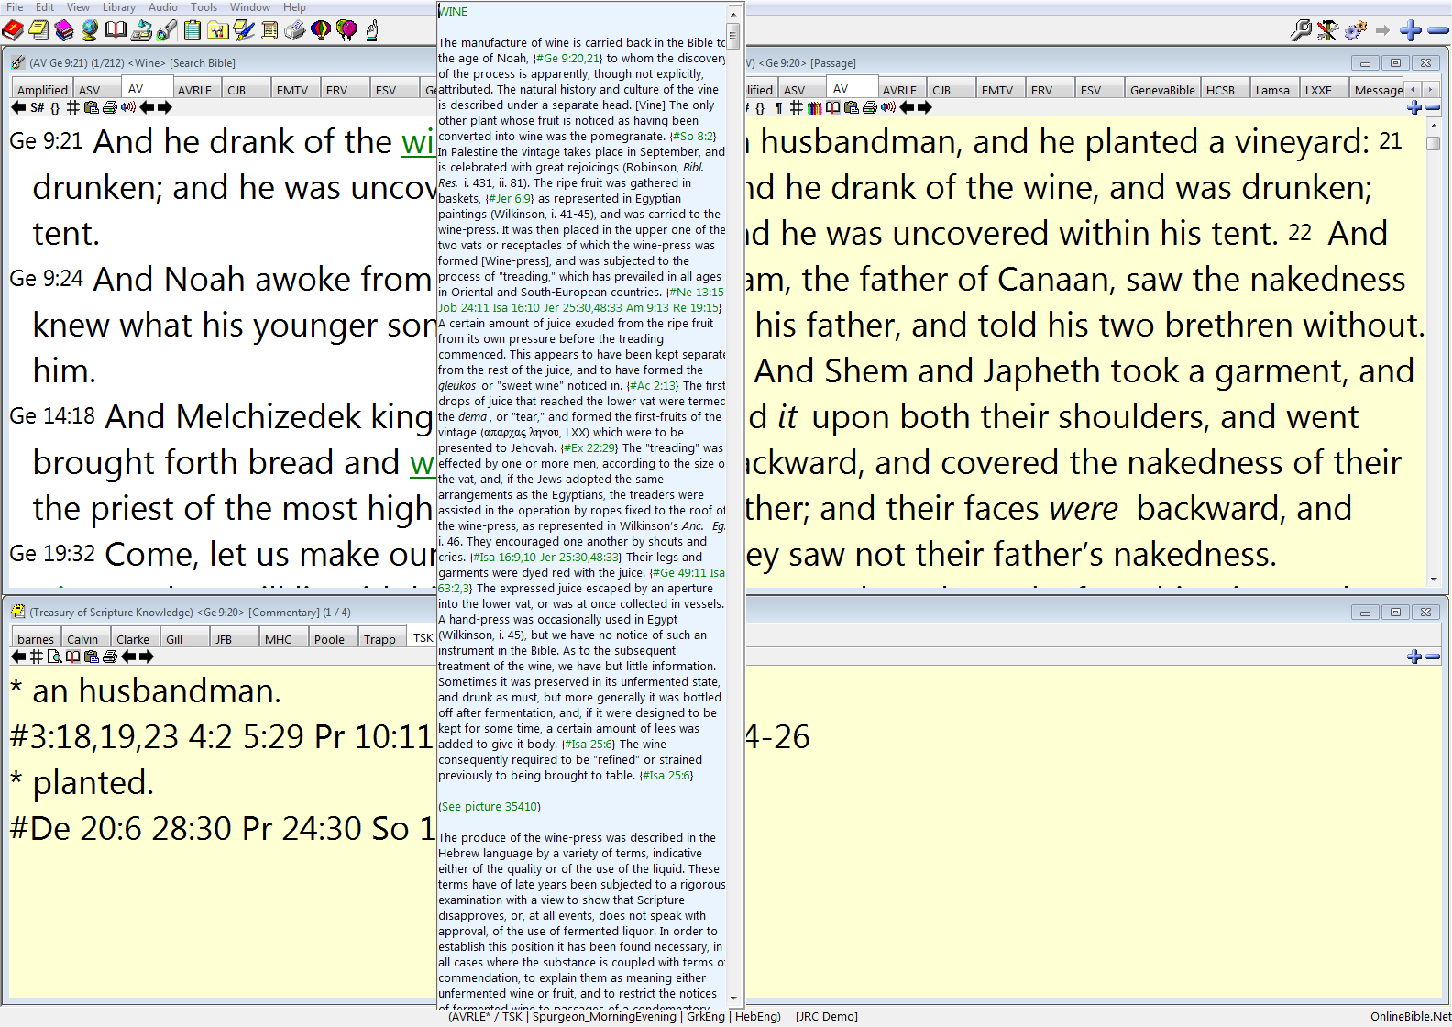
Here is the entry for “wine”
in Smith’s Bible Dictionary
… with hot links to any
cross-references used!

Slide 75
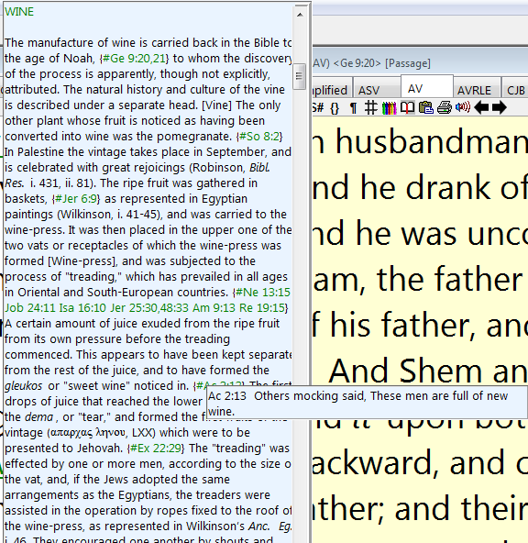

Slide 76
Click on the books to go to the library for a book
The book you select
will appear in a new window.

Slide 77
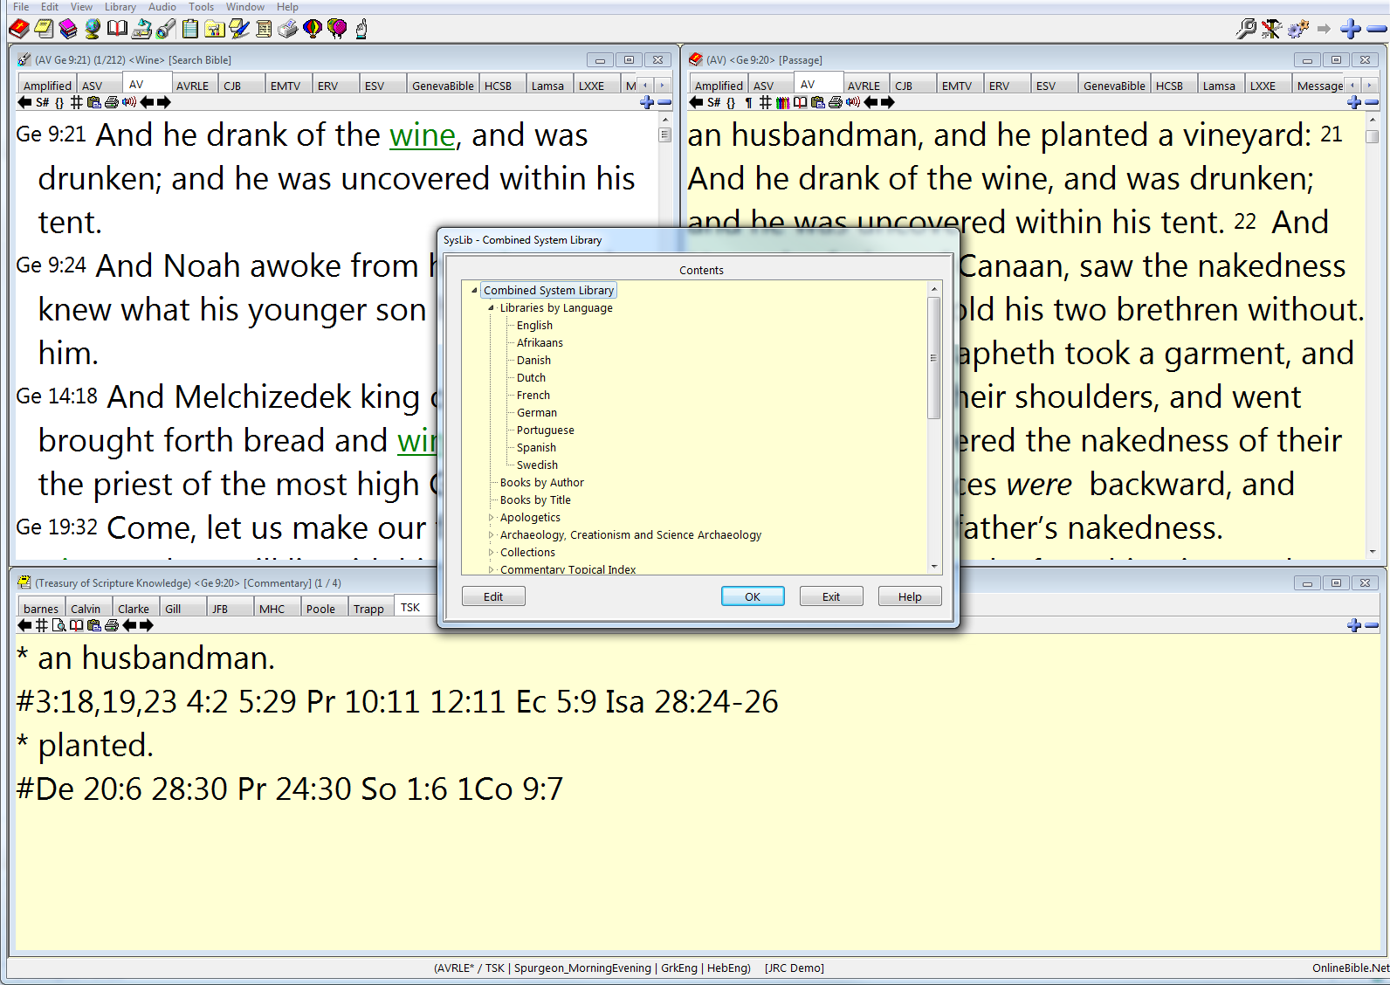
Click on the books to go to the library for a book
A dialog box will appear with all
the books in your extensive library

Slide 78
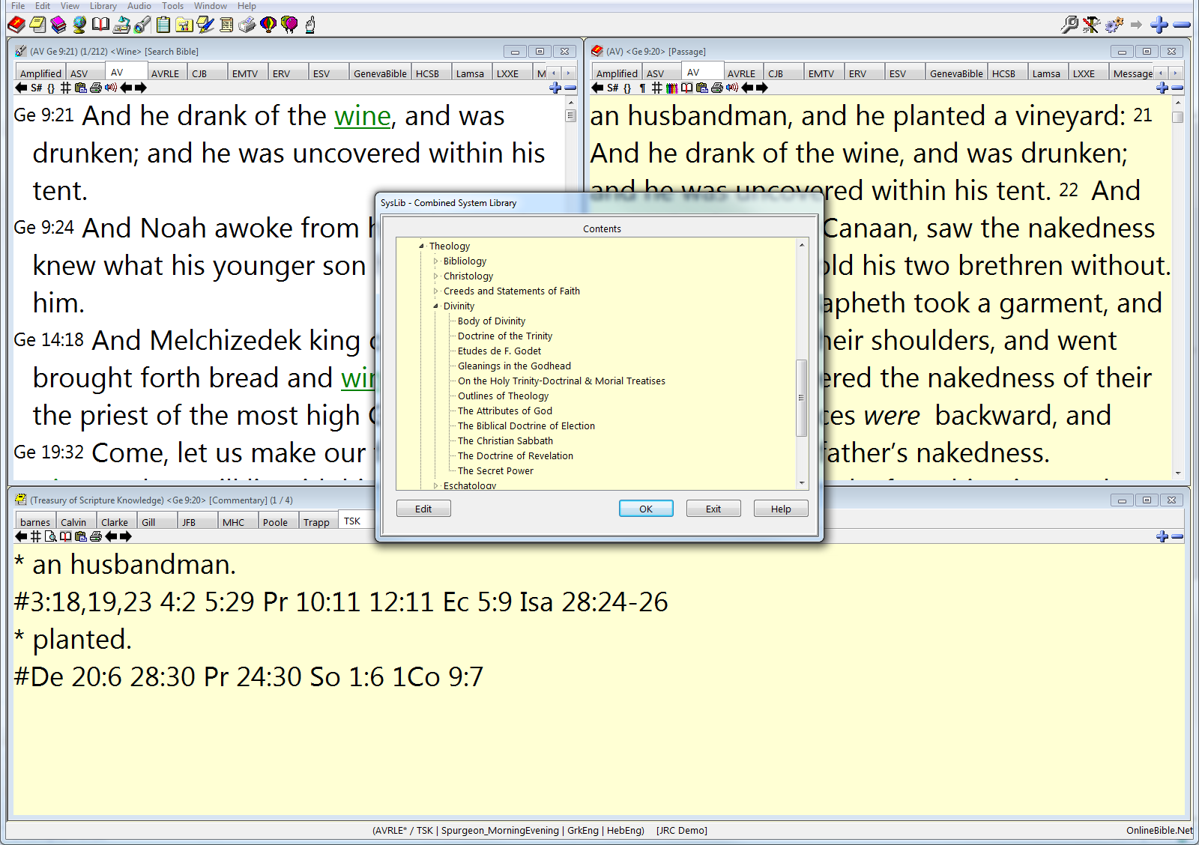
Theology
We want John Gill’s “Body of Divinity”
Divinity

Slide 79
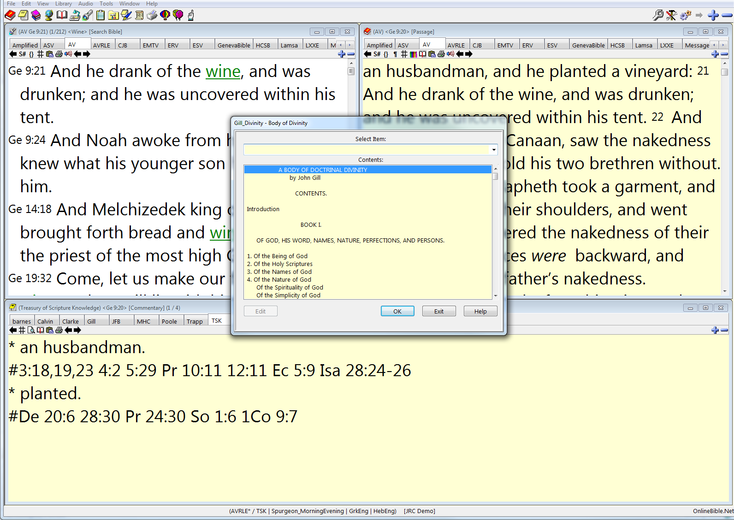
A dialog box will appear with John
Gill’s massive “Body of Divinity”

Slide 80
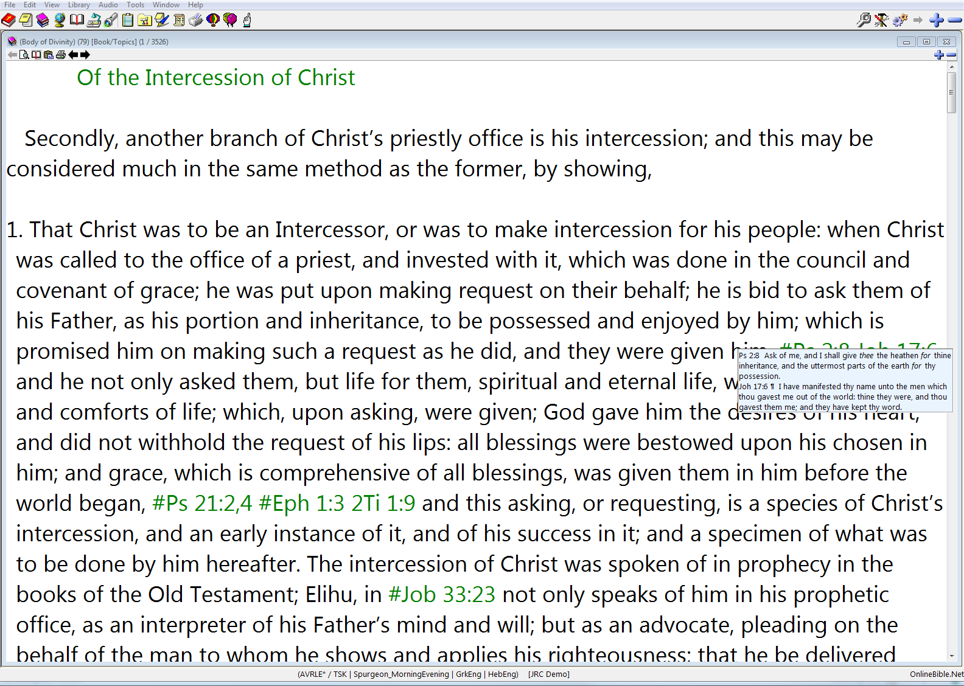
Here is his work on the “Intercession of Christ”
The cross-references are hot links!

Slide 81
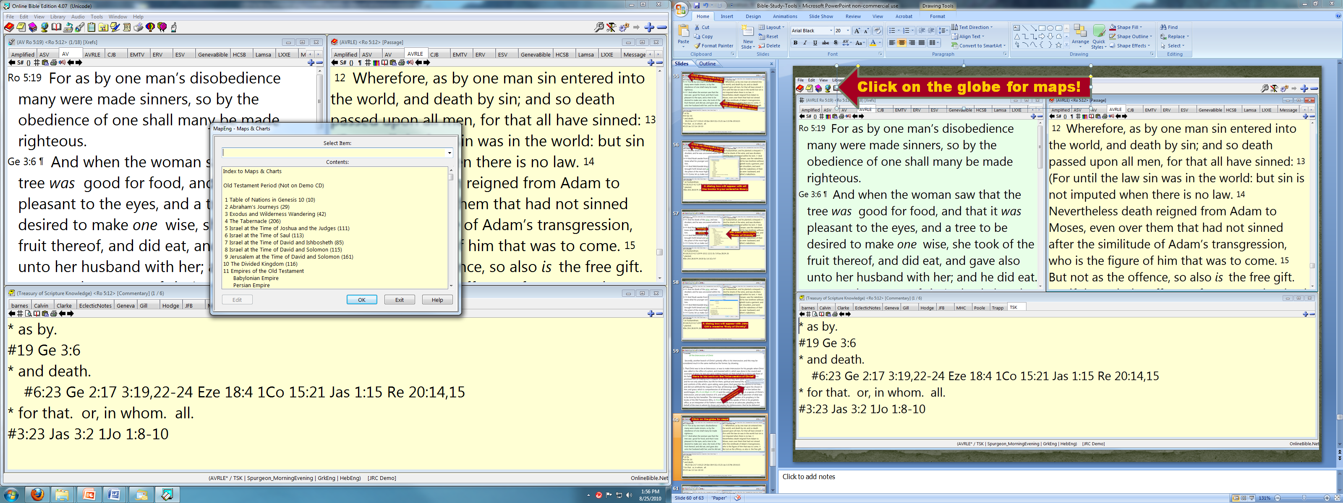
Click on the globe for maps!

Slide 82
We want David’s kingdom

Slide 83
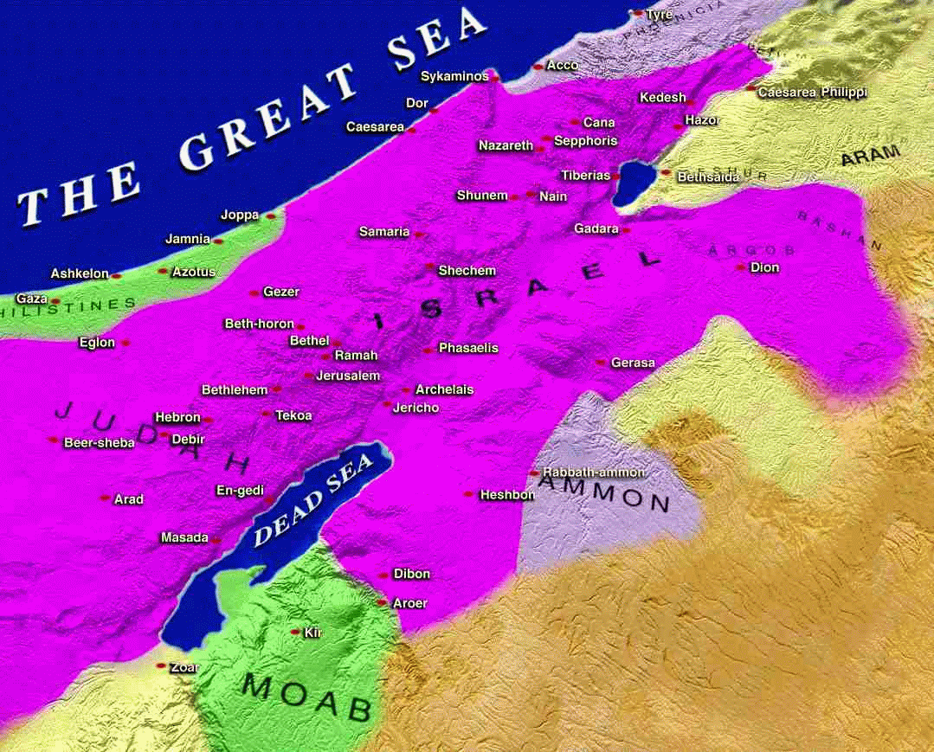

Slide 84
These pages are synchronized
to optimize your Bible study.

Slide 85
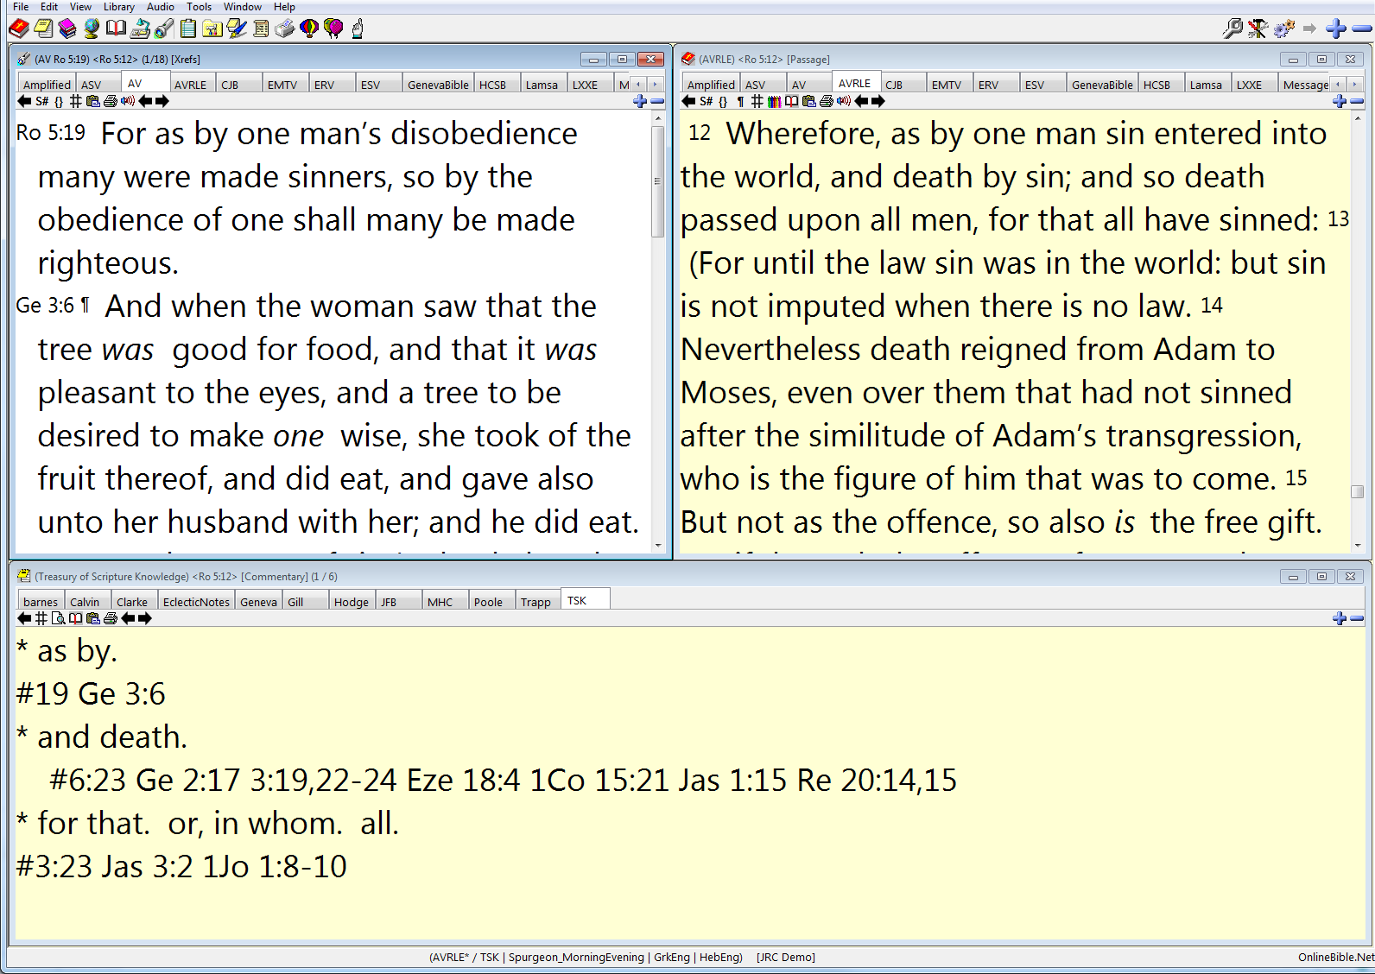
When you select a passage, as
Rom 5:12 in the upper right, the
bottom window has the Treasury
References, and the verses are
in the upper left window. Wow!

Slide 86
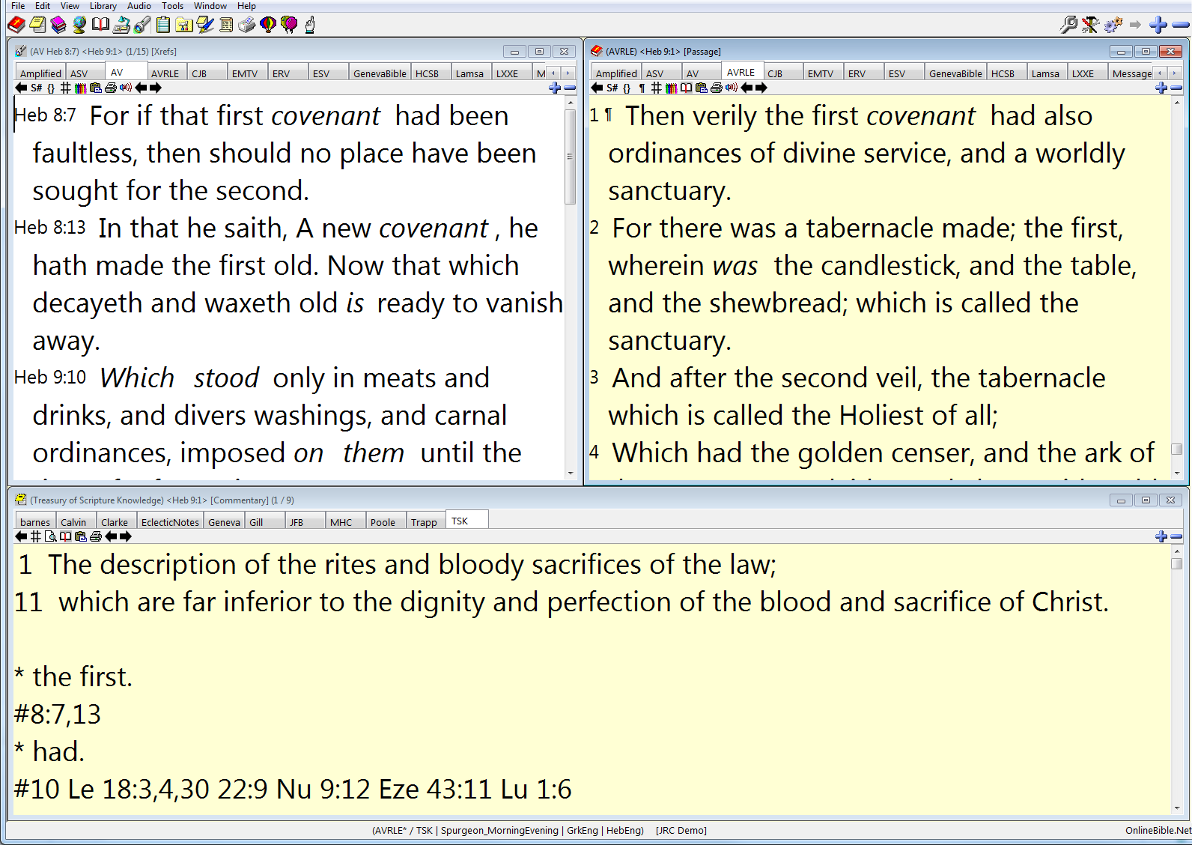
As fast as you can click on
the Bible icon and enter a new
reference, all windows change!

Slide 87
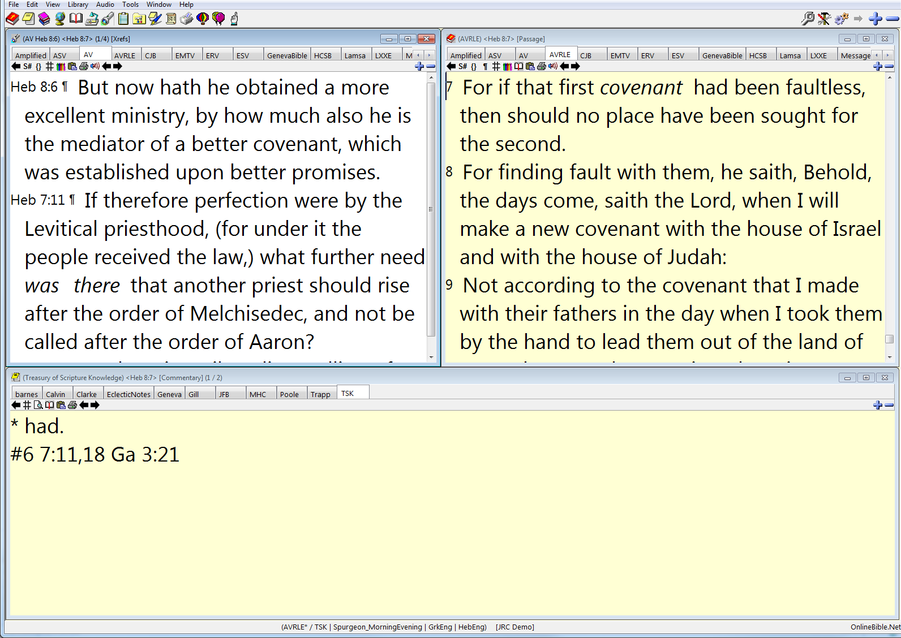
If you like a cross-reference in
the upper left window, a double
click will cause all the windows
to synchronize to your new verse!

Slide 88
A Few Tricks
“Escape” will take you to the previous display of the entire desktop.
Something look quirky or confused? Close the program and open it right back up. All will be well.
Are you confused? Call a friend from this meeting.
Use their FAQ … www.onlinebible.net/faqs.html

Slide 89
You have been introduced to the
basic tools.
Use the small and concise owner’s
manual from inside the DVD case.
Will you invest a few hours to learn
this program to leverage ability in
the Bible? Will you teach your family?

Slide 90
Let’s Go Live!

Slide 91
For Further Study
Bible Study Tools … http://www.letgodbetrue.com/sermons/pdf/bible-study-tools-word.pdf
Link to Online Bible … http://www.onlinebible.net
The study outline … “How to Understand the Bible.”
Sermon outline … “Importance of Teachers and Books”
Sermon outline … “Is God the Author of Confusion?”

