Slide 1
The Rapture!
Saturday, May 21, 2011

Slide 2
The Rapture!
All the Saved Will Be Taken!
Anyone Left Is Lost Forever!
Universe Destroyed Oct 21!

Slide 3


Slide 4


Slide 5
The Rapture!
Saturday, May 21, 2011

Slide 6
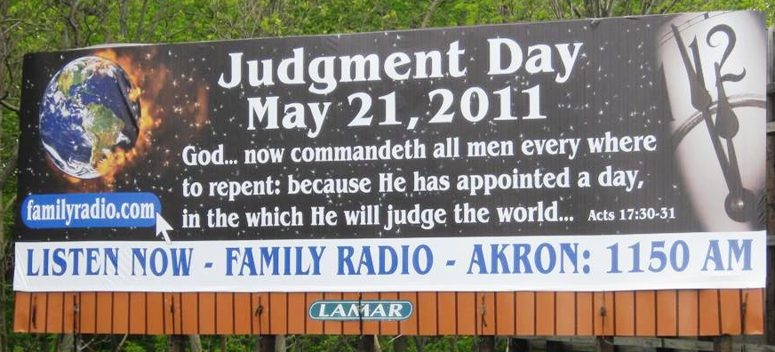

Slide 7
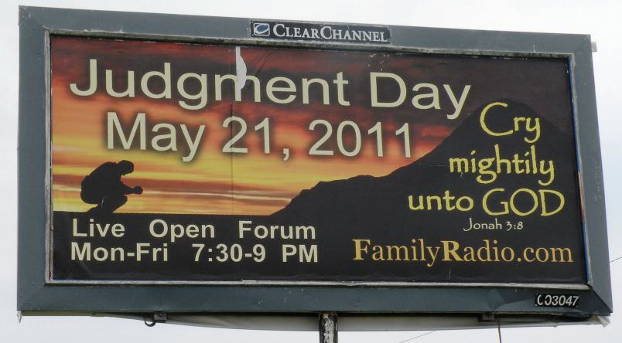

Slide 8
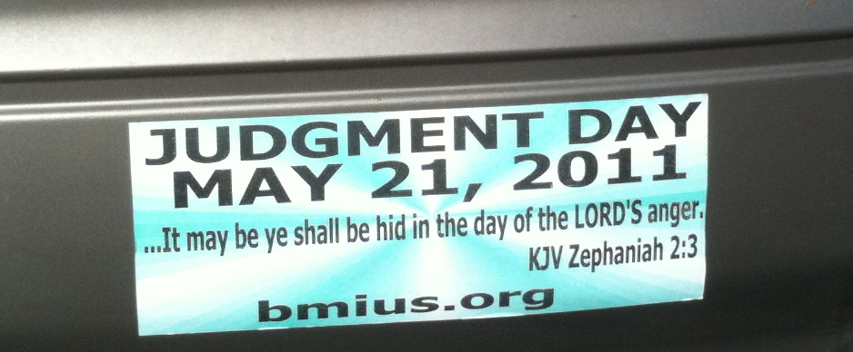

Slide 9


Slide 10
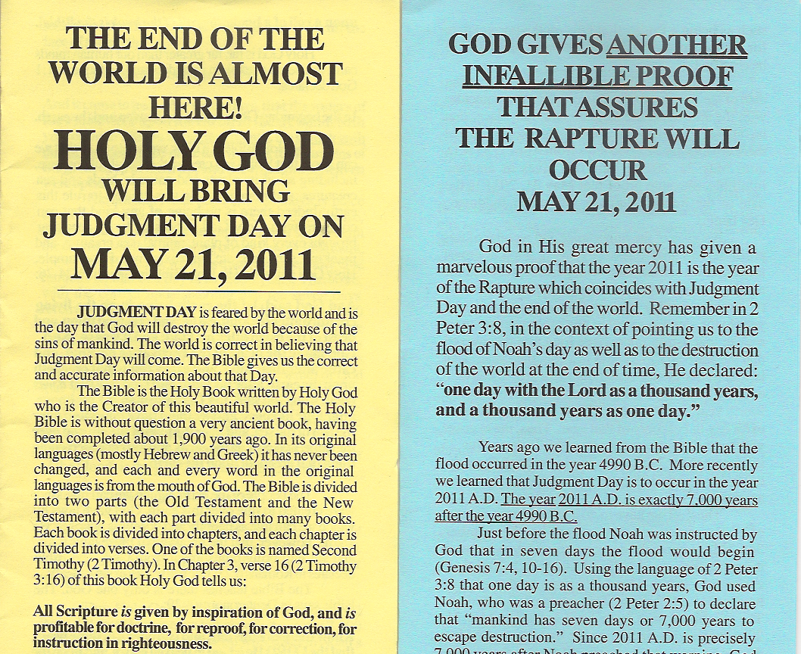

Slide 11
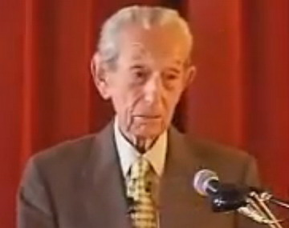
Who Said May 21, 2011?

Slide 12
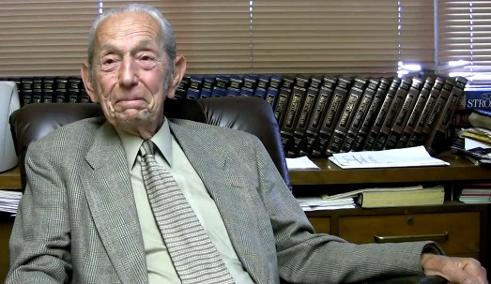
Who Said May 21, 2011?

Slide 13
Who Is Harold Camping?
Born July 21, 1921 (90 years old)
150 radio stations cover the earth
A civil engineer by profession
Left Christian Reformed in 1988

Slide 14
Other Vain Opinions
Jesus was going to come in 1994
Numbers in the Bible hold secrets
Since 1988 no salvation in church
Only he and his radios have truth

Slide 15
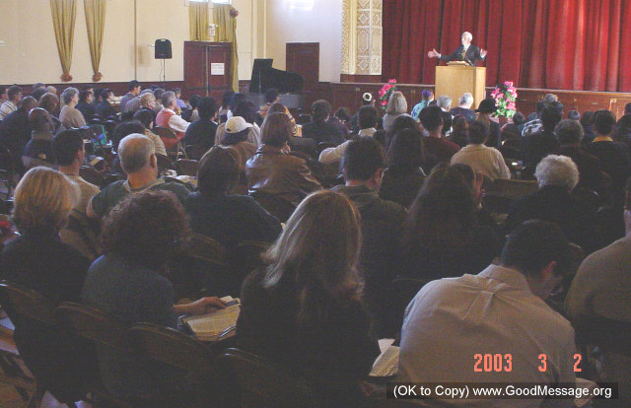
Would Anyone Believe It?

Slide 16
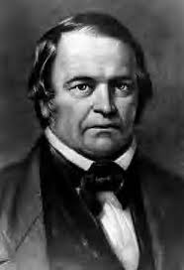
Another William Miller?

Slide 17
What Did Miller Do?
Called for Lord’s Return in 1844
Twice! Since first date failed!
Greatly disillusioned afterwards
It was the “Great Disappointment”

Slide 18
What Did Miller Cause?
Origin of Seventh Day Adventists
Origin of Jehovah’s Witnesses
Ridicule of Christians worldwide
Folly of Bible study in vacuum!

Slide 19
How Did Miller Err?
Personal Bible Study in Vacuum
Saw 2300 days in Daniel 8
Saw Year-Day Principle in Daniel 9
Connected dots for 1844 coming!

Slide 20
How Did Camping Err?
Personal Bible Study in Vacuum
Picked 11,031 B.C. for creation
How? Patriarchs end to end! Huh?
Picked 4,990 B.C. for Flood

Slide 21
How Did Camping Err?
Too eager about Noah’s 7 days
“For yet seven days, and I will cause it to rain upon the earth forty days and forty nights”
Interpreted days by II Peter 3:8
“One day is with the Lord as a thousand years, and a thousand years as one day.”

Slide 22
Check Out His Math
As a civil engineer he digs math
Bible numbers have secret truth
Flood (4990 BC) + 2011 AD = 7000
There is no year 0, so deduct 1

Slide 23
What Errs Did He Make?
Creation was not in 11,031 B.C.
Bible chronology is very important
Patriarchs were not end to end
The Flood was not in 4,990 B.C.

Slide 24
What Errs Did He Make?
God’s one-week warning was that!
II Pet 3:8 illustrates God’s timing
Was Jesus in grave 3,000 years?
Was He tempted 40,000 years?

Slide 25
What Errs Did He Make?
His other errors are Legion
His errors corrupt much doctrine
His errors destroy real Bible study
The Internet allows your research

Slide 26
Does It Really Matter?
Yes! These quacks disgrace truth!
The world can mock Christianity
Truth of Christ’s coming is diluted
Gospel simplicity is overthrown

Slide 27
What Will May 22 Bring?
Some explanation as to his failure
He has done this before (1994)
The world will ridicule Christians
More “study” to pick the next date

Slide 28
What Will We Do?
Bless God for any truth we have
Study only by Bible hermeneutics
Be ready to expose such fools
Turn men to truth of His coming!

Slide 29
For Further Study
Hear it from his own mouth … http://www.youtube.com/watch?v=rlWlcU7UvpU.
What About 2300 Days? … http://www.letgodbetrue.com/sermons/pdf/days-of-daniel-8.pdf.
Harold Camping’s Heresies … http://www.jesus-is-savior.com/Wolves/harold_camping.htm.
Camping’s Heresies … http://www.eaec.org/bibleanswers/Harold-Camping-A-Man-With-No-Shame.htm.
Harold Camping’s Heresies … http://www.scionofzion.com/depart_out.htm.
Camping’s Numbers … http://www.bibleprophecyblog.com/2011/03/harold-camping-playing-with-numbers.html.
Harold Camping Heresies … http://www.freerepublic.com/focus/f-religion/2691574/posts.
Perilous Times … http://www.letgodbetrue.com/sermons/pdf/perilous-times.pdf.
www.LetGodBeTrue.com

