Slide 1
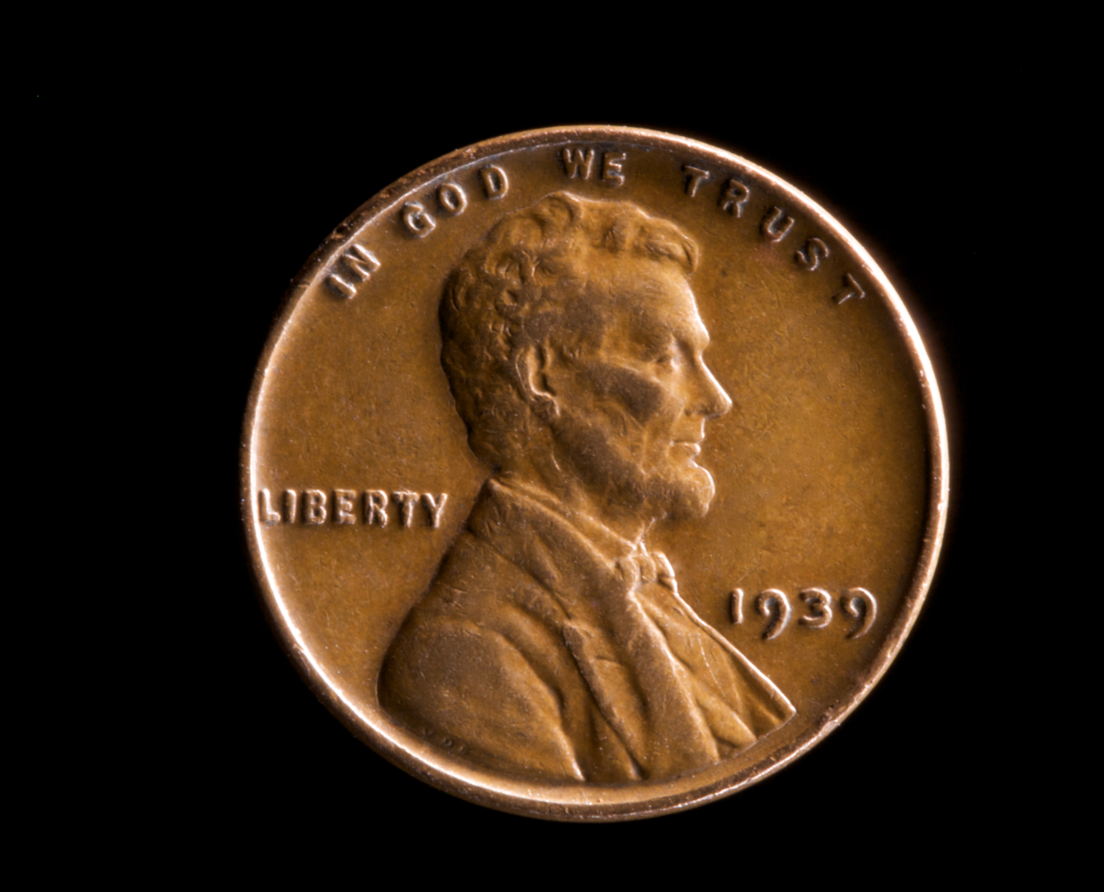
A Penny Saved

Slide 2
Does God Care?
If you give to Him or not?
If you live within your income?
If you limit your expenses to save?
If you have extra to give to others?
If you live in debt due to spending?

Slide 3
Does God Care?
“Will a man rob God? Yet ye have robbed me. But ye say, Wherein have we robbed thee? In tithes and offerings. Ye are cursed with a curse: for ye have robbed me, even this whole nation.”
Malachi 3:8-9

Slide 4
Does God Care?
“Will a man rob God? Yet ye have robbed me. But ye say, Wherein have we robbed thee? In tithes and offerings. Ye are cursed with a curse: for ye have robbed me, even this whole nation.”
Malachi 3:8-9

Slide 5
Does God Care?
“Will a man rob God? Yet ye have robbed me. But ye say, Wherein have we robbed thee? In tithes and offerings. Ye are cursed with a curse: for ye have robbed me, even this whole nation.”
Malachi 3:8-9

Slide 6
Does God Care?
“Will a man rob God? Yet ye have robbed me. But ye say, Wherein have we robbed thee? In tithes and offerings. Ye are cursed with a curse: for ye have robbed me, even this whole nation.”
Malachi 3:8-9

Slide 7
Does God Care?
“Will a man rob God? Yet ye have robbed me. But ye say, Wherein have we robbed thee? In tithes and offerings. Ye are cursed with a curse: for ye have robbed me, even this whole nation.”
Malachi 3:8-9

Slide 8
Does God Care?
“Will a man rob God? Yet ye have robbed me. But ye say, Wherein have we robbed thee? In tithes and offerings. Ye are cursed with a curse: for ye have robbed me, even this whole nation.”
Malachi 3:8-9

Slide 9
Does God Care?
“Will a man rob God? Yet ye have robbed me. But ye say, Wherein have we robbed thee? In tithes and offerings. Ye are cursed with a curse: for ye have robbed me, even this whole nation.”
Malachi 3:8-9

Slide 10
Does God Care?
“Go to the ant, thou sluggard; consider her ways, and be wise … Provideth her meat in the summer, and gathereth her food in the harvest” (Prov 6:6-8).
“There be four things which are little upon the earth, but they are exceeding wise: The ants are a people not strong, yet they prepare their meat in the summer” (Prov 30:24-25).

Slide 11
Does God Care?
“He that loveth pleasure shall be a poor man: he that loveth wine and oil shall not be rich.”
Proverbs 21:17
“There is treasure to be desired and oil in the dwelling of the wise; but a foolish man spendeth it up.”
Proverbs 21:20

Slide 12
Does God Care?
“He also that is slothful in his work is brother to him that is a great waster.”
Proverbs 18:9
Spending can make you like a sluggard!
Why earn it, just to blow it by spending?
“…Strong men retain riches” (Pr 11:16).

Slide 13
Does God Care?
“And that ye study to be quiet, and to do your own business, and to work with your own hands, as we commanded you; That ye may walk honestly toward them that are without, and that ye may have lack of nothing” (I Thess 4:11-12).
Let him that stole steal no more: but rather let him labour, working with his hands the thing which is good, that he may have to give to him that needeth.”
Ephesians 4:28

Slide 14
Does God Care?
“The LORD shall open unto thee his good treasure, the heaven to give the rain unto thy land in his season, and to bless all the work of thine hand: and thou shalt lend unto many nations, and thou shalt not borrow” (Deut 28:12).
“And the LORD shall make thee the head, and not the tail; and thou shalt be above only, and thou shalt not be beneath” (Deut 28:13)

Slide 15
Does God Care?
“The rich ruleth over the poor, and the borrower is servant to the lender.”
Proverbs 22:7
“Art thou called being a servant? care not for it: but if thou mayest be made free, use it rather … Ye are bought with a price; be not ye the servants of men.”
I Corinthians 7:21-23

Slide 16
A Penny Saved

Slide 17
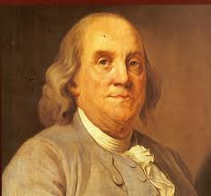
Benjamin Franklin
1706-1790

Slide 18
Benjamin Franklin
                “A penny saved is a penny earned.”
                Not spending a penny is like earning one.
                The choice not to spend is one to earn.
                A penny foolishly spent is earnings lost.
                A penny not spent is income to yourself.

Slide 19
Benjamin Franklin
                “A penny saved is a penny earned.”
                Ben was a religious skeptic and scorner.
                There is no reason to see him a believer.
                His penny saying is good, far as it goes.
                There is more for Christians to consider.

Slide 20
The First Use of Income
                Pay God First (10%)
                God expects and deserves firstfruits.
                He does not get leftovers, or you sin.
                If you save a penny by not spending it …
                … you have earned 1.11 pennies.

Slide 21
The First Use of Income
                Pay God First (10%)
                You must earn 1.11 pennies to have one.
                Your first use is giving God 10% (.11).
                Earning 1.11 … giving .11 … leaves 1.
                Spending must be grossed up for giving.

Slide 22
The Second Use of Income
                Pay Yourself Second (10%)
                God expects you to save systematically.
                So we save conscientiously, off the top.
                If you save a penny by not spending it …
                … you have earned 1.11 pennies.

Slide 23
The Second Use of Income
                Pay Yourself Second (10%)
                You must earn 1.11 pennies to have one.
                Your second use is saving 10% (.11).
                Earning 1.11 … saving .11 … leaves 1.
                Spending must be grossed up for saving.

Slide 24
The Third Use of Income
                Pay Caesar Third (25%)
                God commands you to support Caesar.
                He takes it off the top without asking.
                If you save a penny by not spending it …
                … you have earned 1.33 pennies.

Slide 25
The Fourth Use of Income
                Pay Living Expenses Next (50%)
                God commands you to pay all your bills.
                If not, bad things happen everywhere.
                If you save a penny by not spending it …
                … you have earned 2.00 pennies.

Slide 26
Can You Add Pennies?
                A penny after giving and saving
                A penny saved after giving is worth 1.11.
                A penny saved after saving is worth 1.11.
                A penny saved after both is worth 1.24!
                You must earn 1.24 pennies to have one.

Slide 27
Look at a Full Budget
                Giving 10%
                Saving 10%
                Taxes 25%
                Living 50%
                Discretionary 5%
                Total 100%

Slide 28
Or Look at it This Way
                Giving 10%
                Saving 10%
                Taxes 25%
                Living 50%
                Discretionary 5%

Slide 29
95% of Income Is Spent
                If you do not spend a discretionary penny, it is equal to earning 20 pennies!
                If you spend a discretionary penny, then it is like taking 20 pennies from income.
                Anything done with discretionary pennies has an effect 20 times on your income.

Slide 30
Your Multiplier is 20 Times
                For Example
                You want to buy a $100 cell phone.
                If you buy it, you used $2000 of income.
                If you save it, you find $2000 of income.
                It will take $2000 of income to pay for it.

Slide 31
Can You Cut Expenses?
                It is cost of high living that gets most
                Do you spend money like Uncle Sam?
                Shop less. Buy only what is needed.
                If lacking discipline, cut up credit cards
                Do not be too proud to buy used anything

Slide 32
Can You Cut Expenses?
                Vacations are only for those with savings
                Eating out is an extravagant waste
                Vehicle for non-working person is costly
                Convenience foods cost you per pound
                Cell phone a necessity? Hardly!

Slide 33
Can You Cut Expenses?
                Every time you turn ignition you spend
                Raise or lower temperature by season
                Split a meal out – it can help two ways!
                If you cannot pay cash for it, forget it!
                Fight “sales” – do you need the savings?

Slide 34
Cost-Cutting Is Important
                To give to God liberally at all times
                To live easily within your means
                To always save and be wise for future
                To have extra to give to others
                To be free as the head and not the tail
                To simplify your life for godly peace
                To protect against the coming trouble

Slide 35
For Further Study
                Bible Economics … http://www.letgodbetrue.com/sermons/pdf/bible-economics-86.pdf.
                Proverbs 21:17 … http://www.letgodbetrue.com/proverbs/21_17.htm.
                Proverbs 21:20 … http://www.letgodbetrue.com/proverbs/21_20.htm.
                Proverbs 11:16 … http://www.letgodbetrue.com/proverbs/11_16.htm.
                Proverbs 6:8 … http://www.letgodbetrue.com/proverbs/06_08.htm.
                Proverbs 30:25 … http://www.letgodbetrue.com/proverbs/30_25.htm.
                Proverbs 22:7 … http://www.letgodbetrue.com/proverbs/22_07.htm.
                Two Financial Concerns … http://www.letgodbetrue.com/sermons/pdf/two-financial-concerns.pdf.
                www.LetGodBeTrue.com

